Slide 1
CHAPTER 7
KINETICS OF A PARTICLE: ENERGY AND MOMENTUM

Slide 2

7.1 Work done by a force

Slide 3
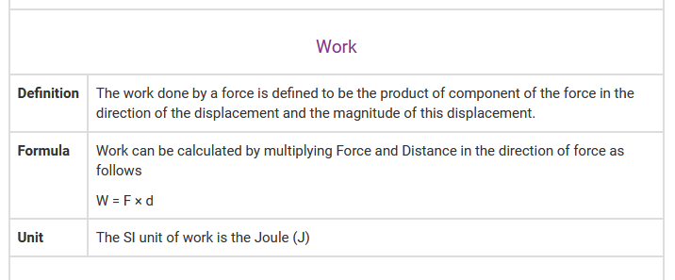

Slide 4
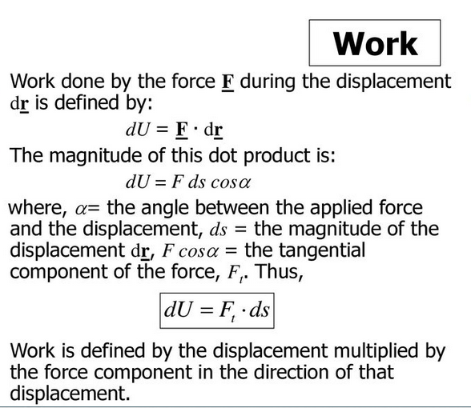

Slide 5
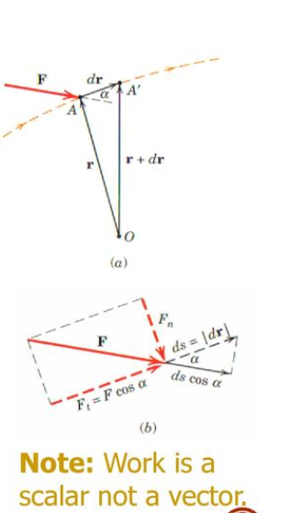

Slide 6
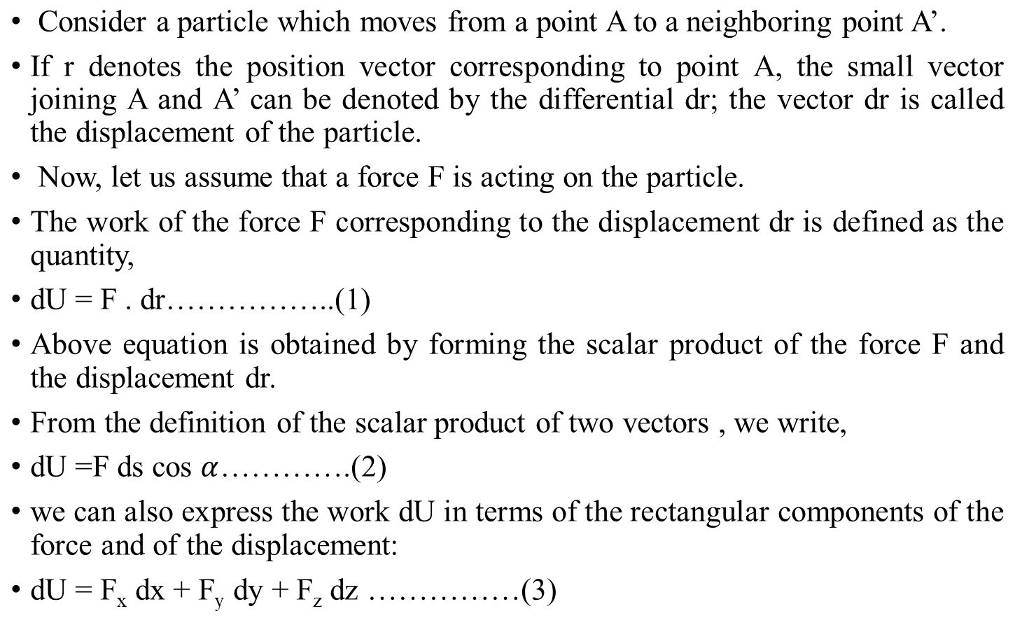

Slide 7
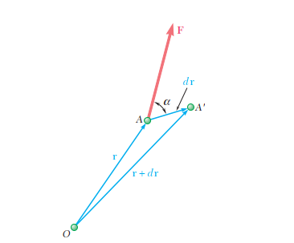
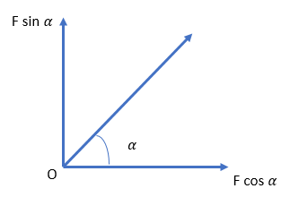
O

Slide 8

If the force F has the same direction as dr, the work dU
reduces to F ds.
If F has a direction opposite to that of dr, the work is dU = -F ds.
Finally, if F is perpendicular to dr, the work dU is zero.
The work of F during a finite displacement of the particle from
A1 to A2 (Fig. a) is obtained by integrating Eq. (1) along the
path described by the particle. This work, denoted by U1 2, is

Slide 9
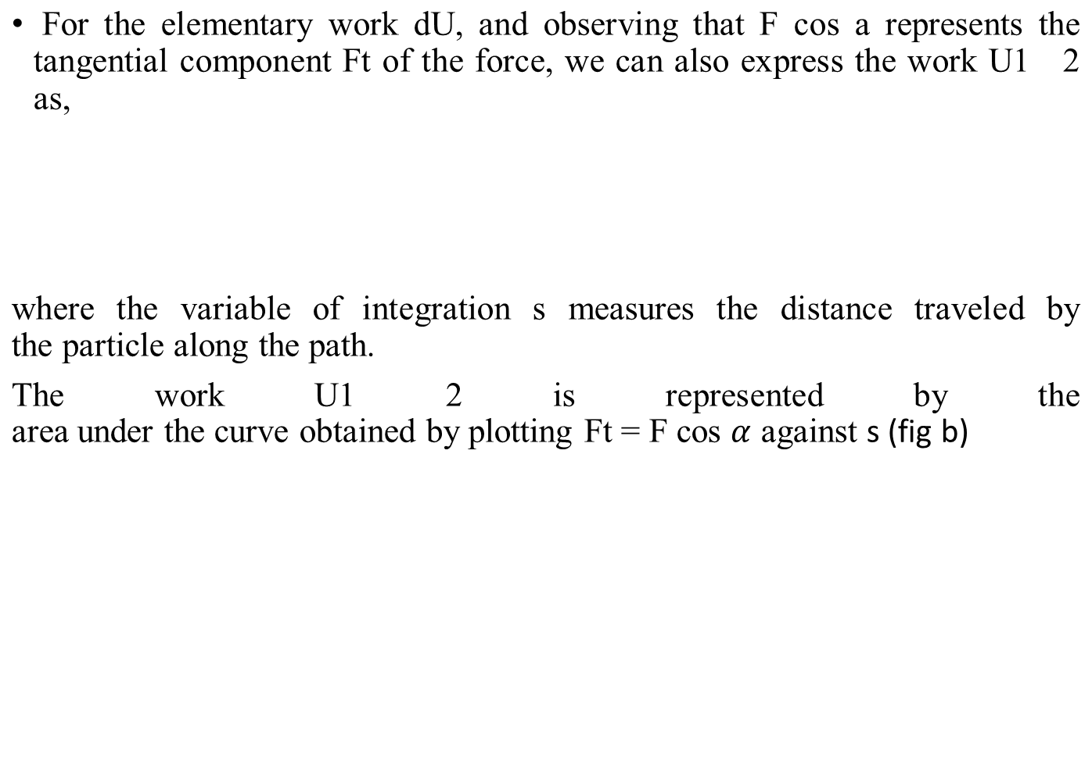
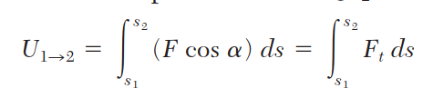


Slide 10
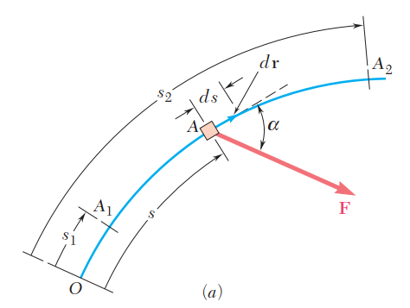
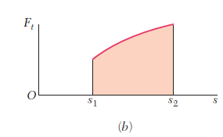

Slide 11
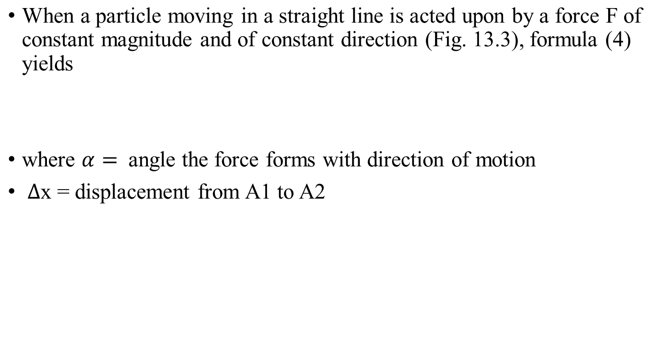

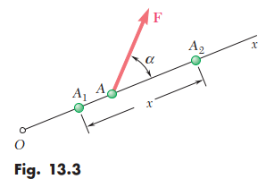
Work of a Constant Force in Rectilinear Motion

Slide 12
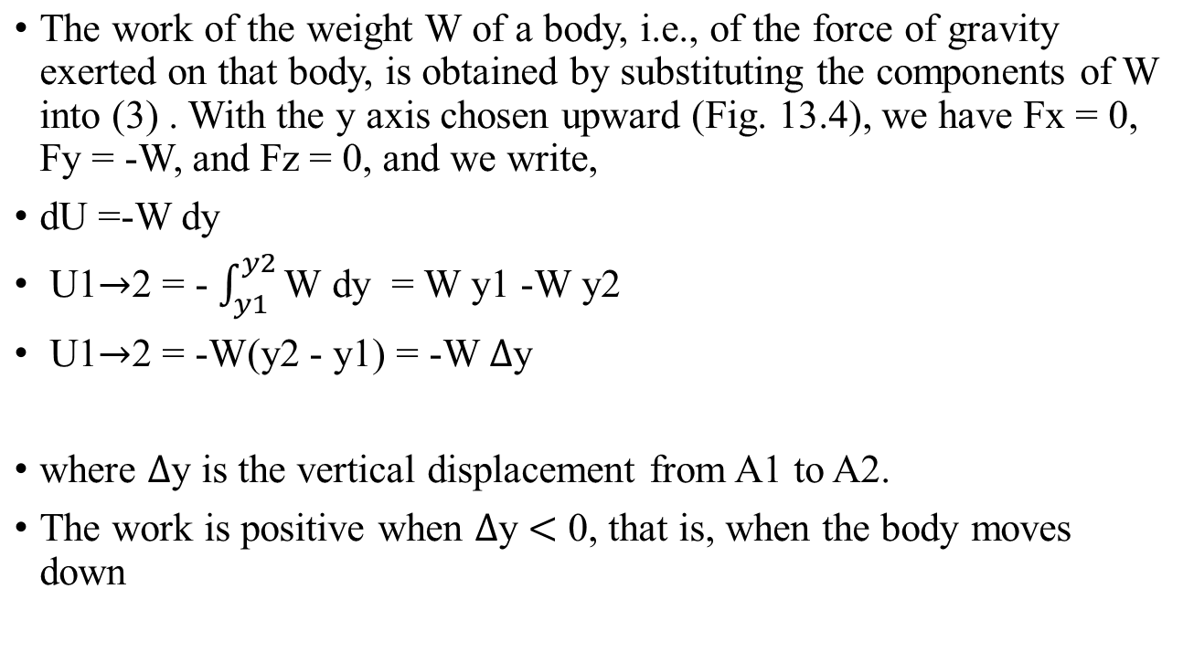
Work of the Force of Gravity.

Slide 13
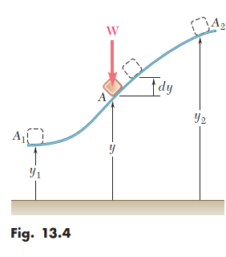

Slide 14
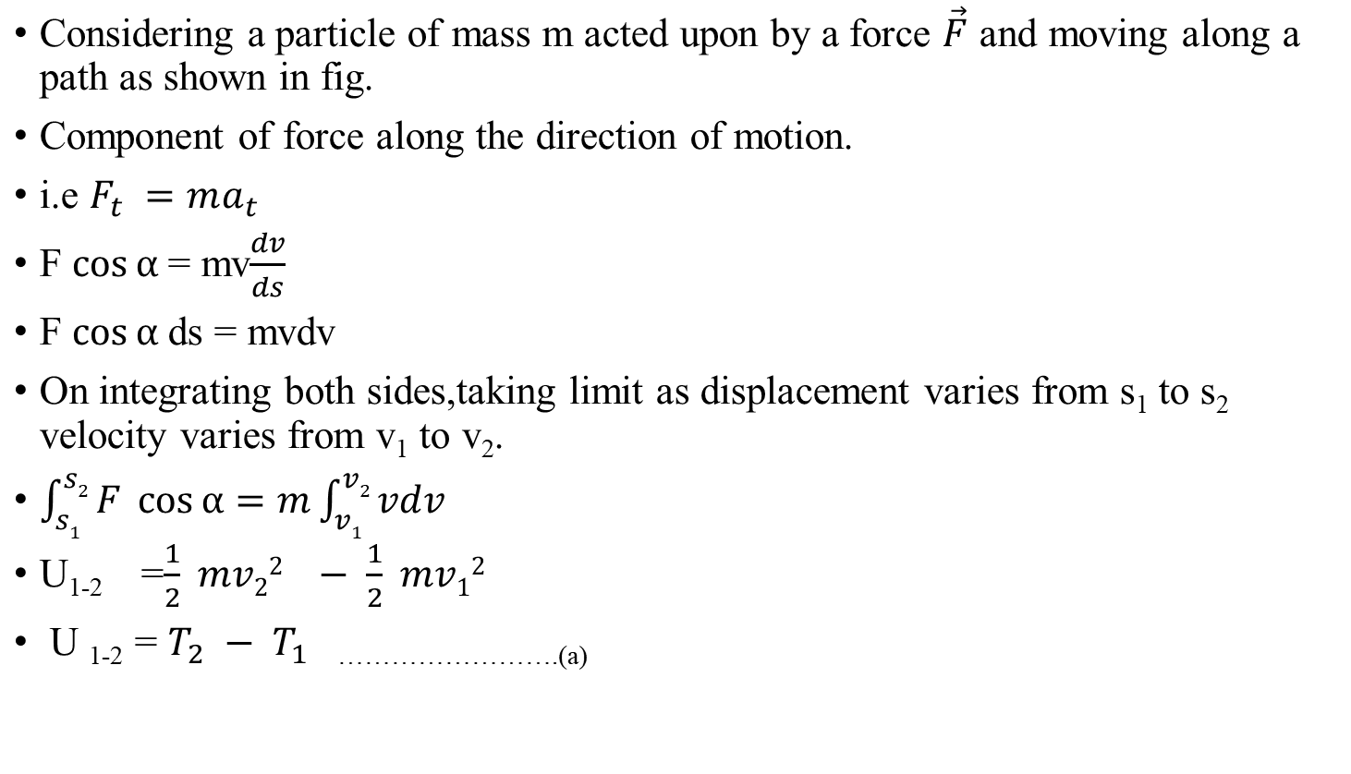
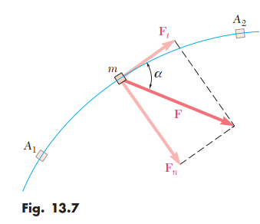
Kinetic energy of a Particle

Slide 15
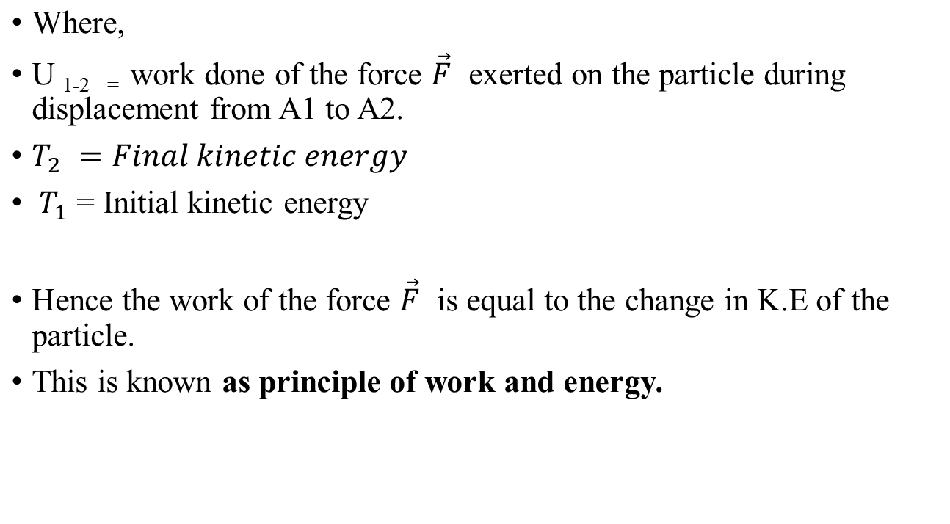

Slide 16
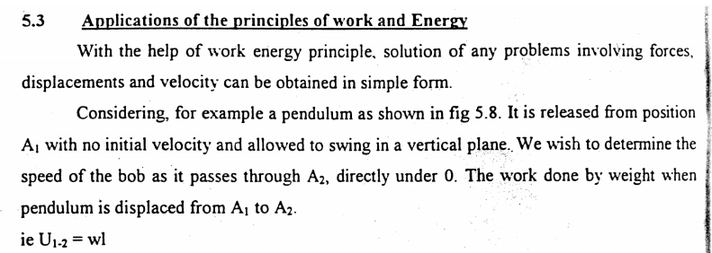

Slide 17
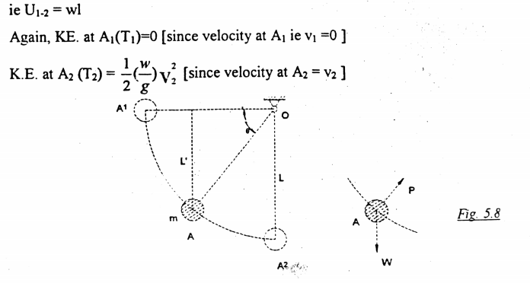

Slide 18
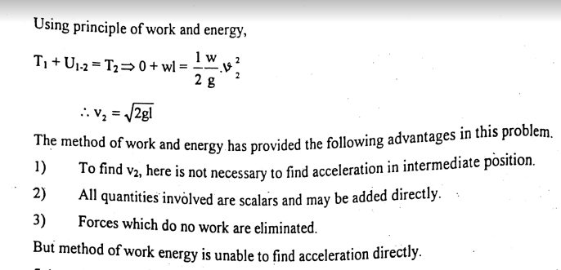

Slide 19
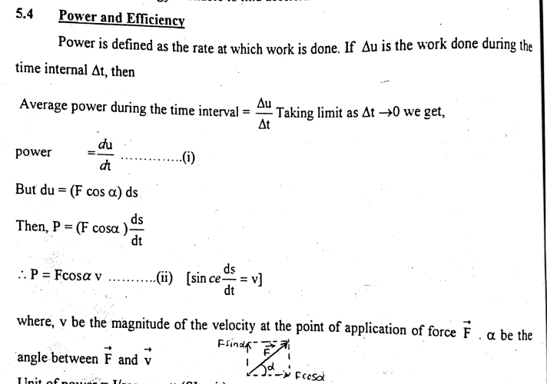

Slide 20
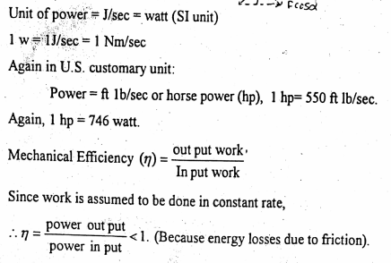

Slide 21
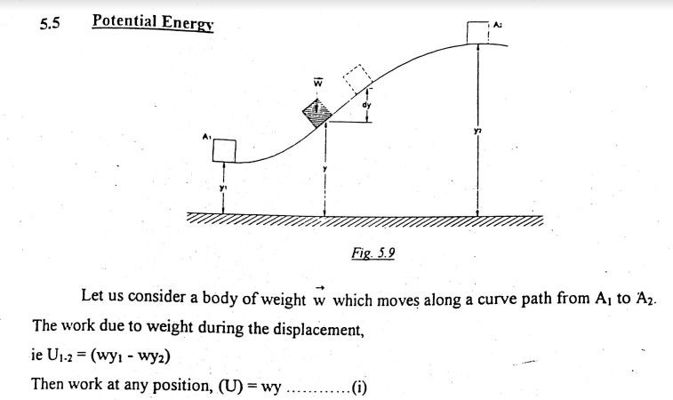

Slide 22
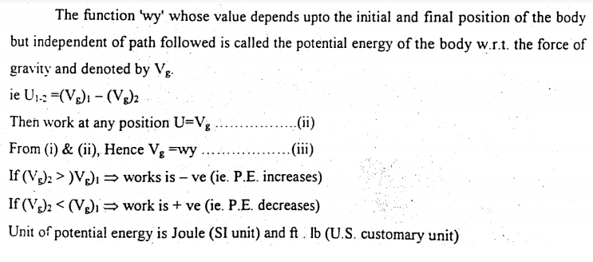

Slide 23
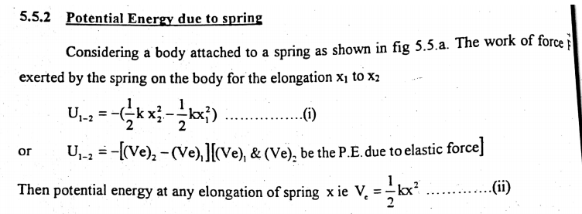

Slide 24
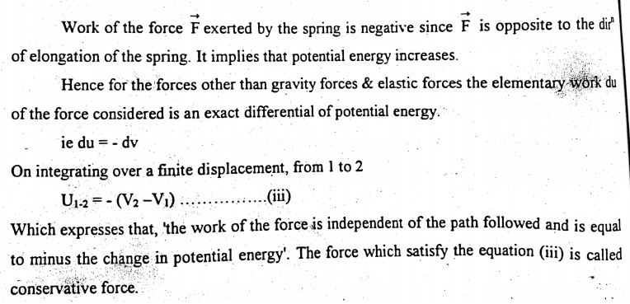

Slide 25
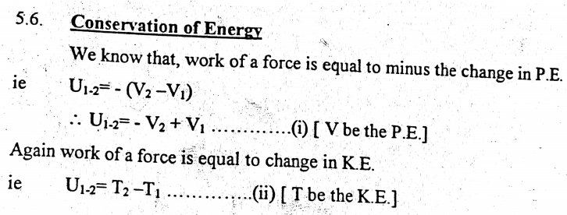

Slide 26
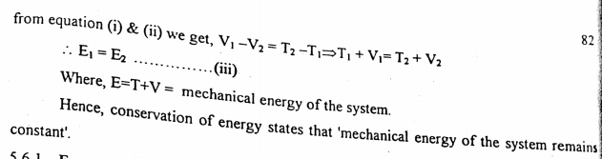

Slide 27
3.Impulse and momentum method

Slide 28
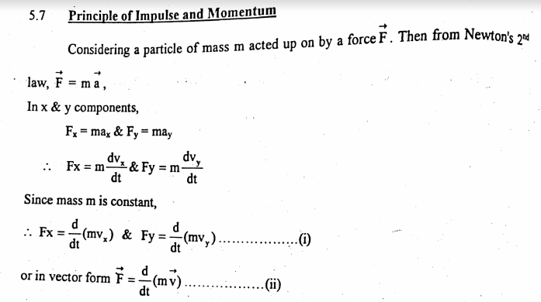

Slide 29
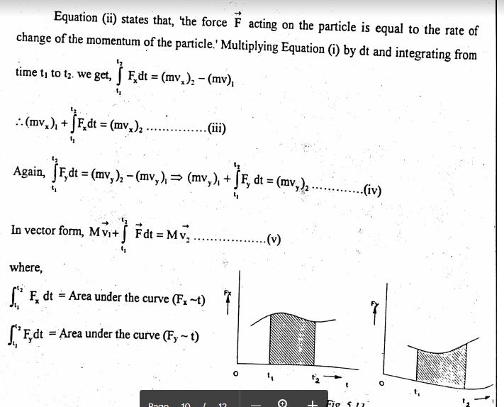

Slide 30
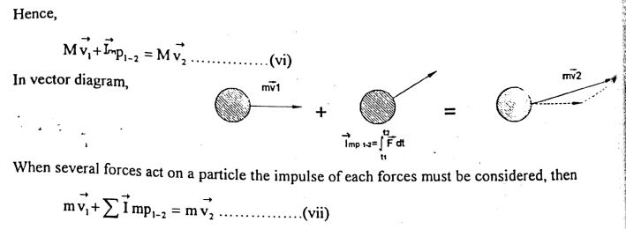

Slide 31
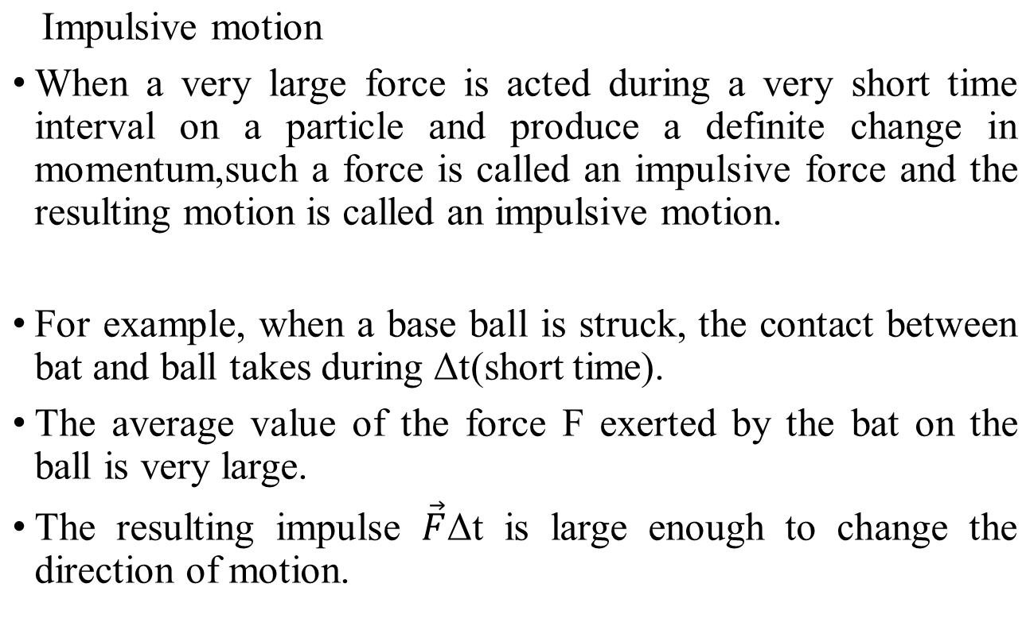
Impulsive motion and impact

Slide 32
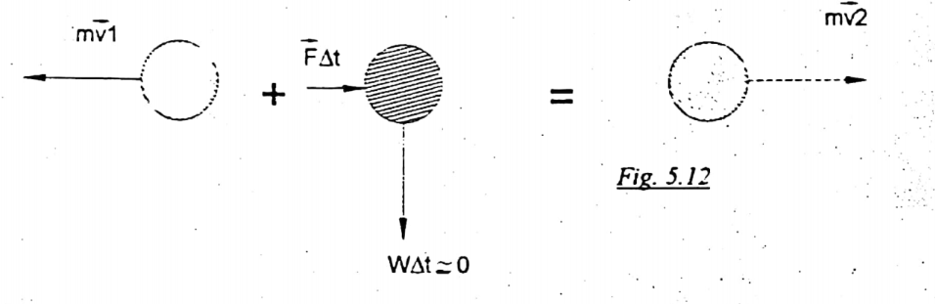

Slide 33
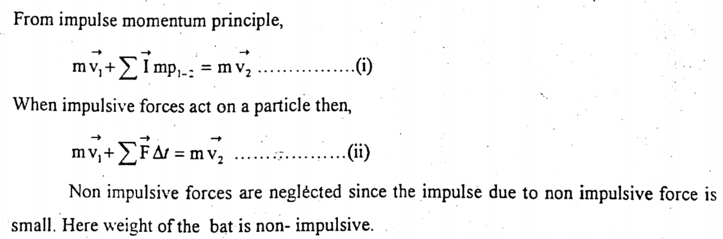

Slide 34
Impact
A collision between two bodies which occurs in very short interval of time and during which the two bodies exert on each other relatively large forces is called an impact.
The common normal to the surfaces in contact during the impact is called the line of impact or line of action.
If the mass centers of the two colliding bodies are located on this line of impact, the impact is a central impact otherwise eccentric.

Slide 35
Direct impact
If velocities of the two particles are directed along the line of impact it is said to be direct impact.
Oblique Impact
If either of both particles moves along the line other than the line of impact, the impact is said to be an oblique impact.

Slide 36
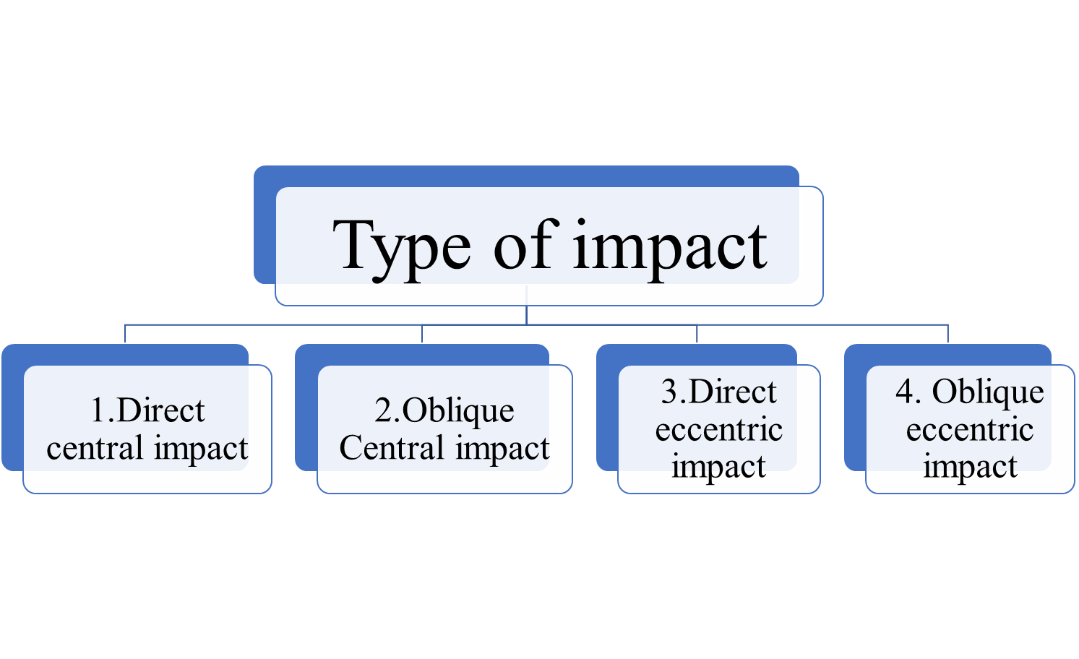
Type of impact:

Slide 37
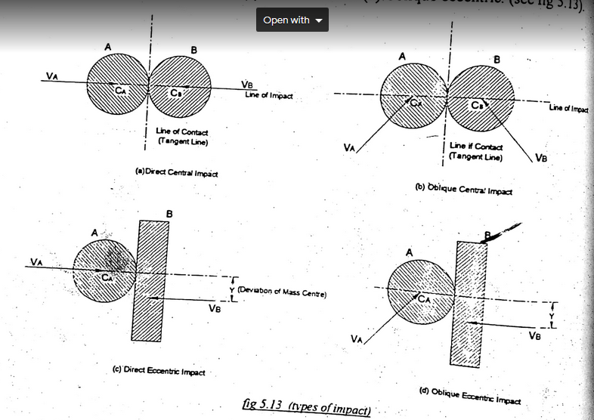

Slide 38
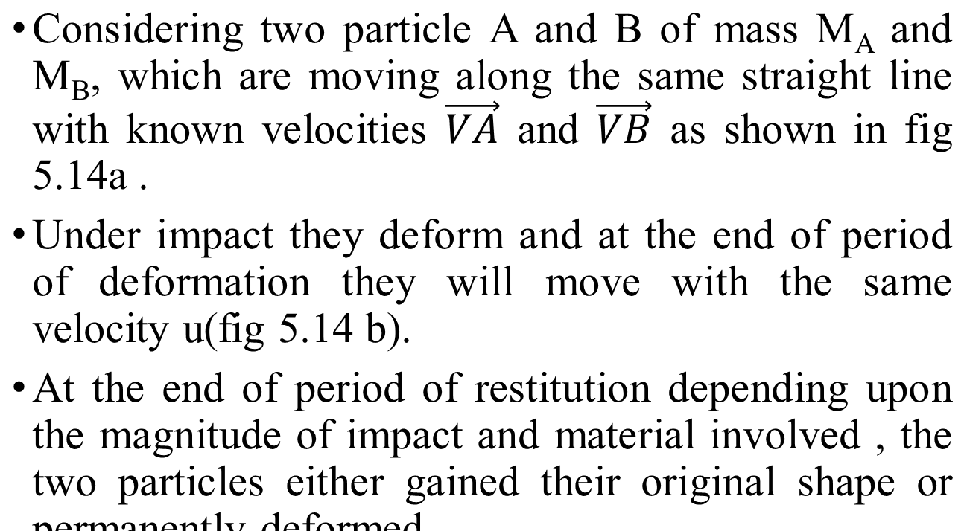
Direct Central Impact

Slide 39
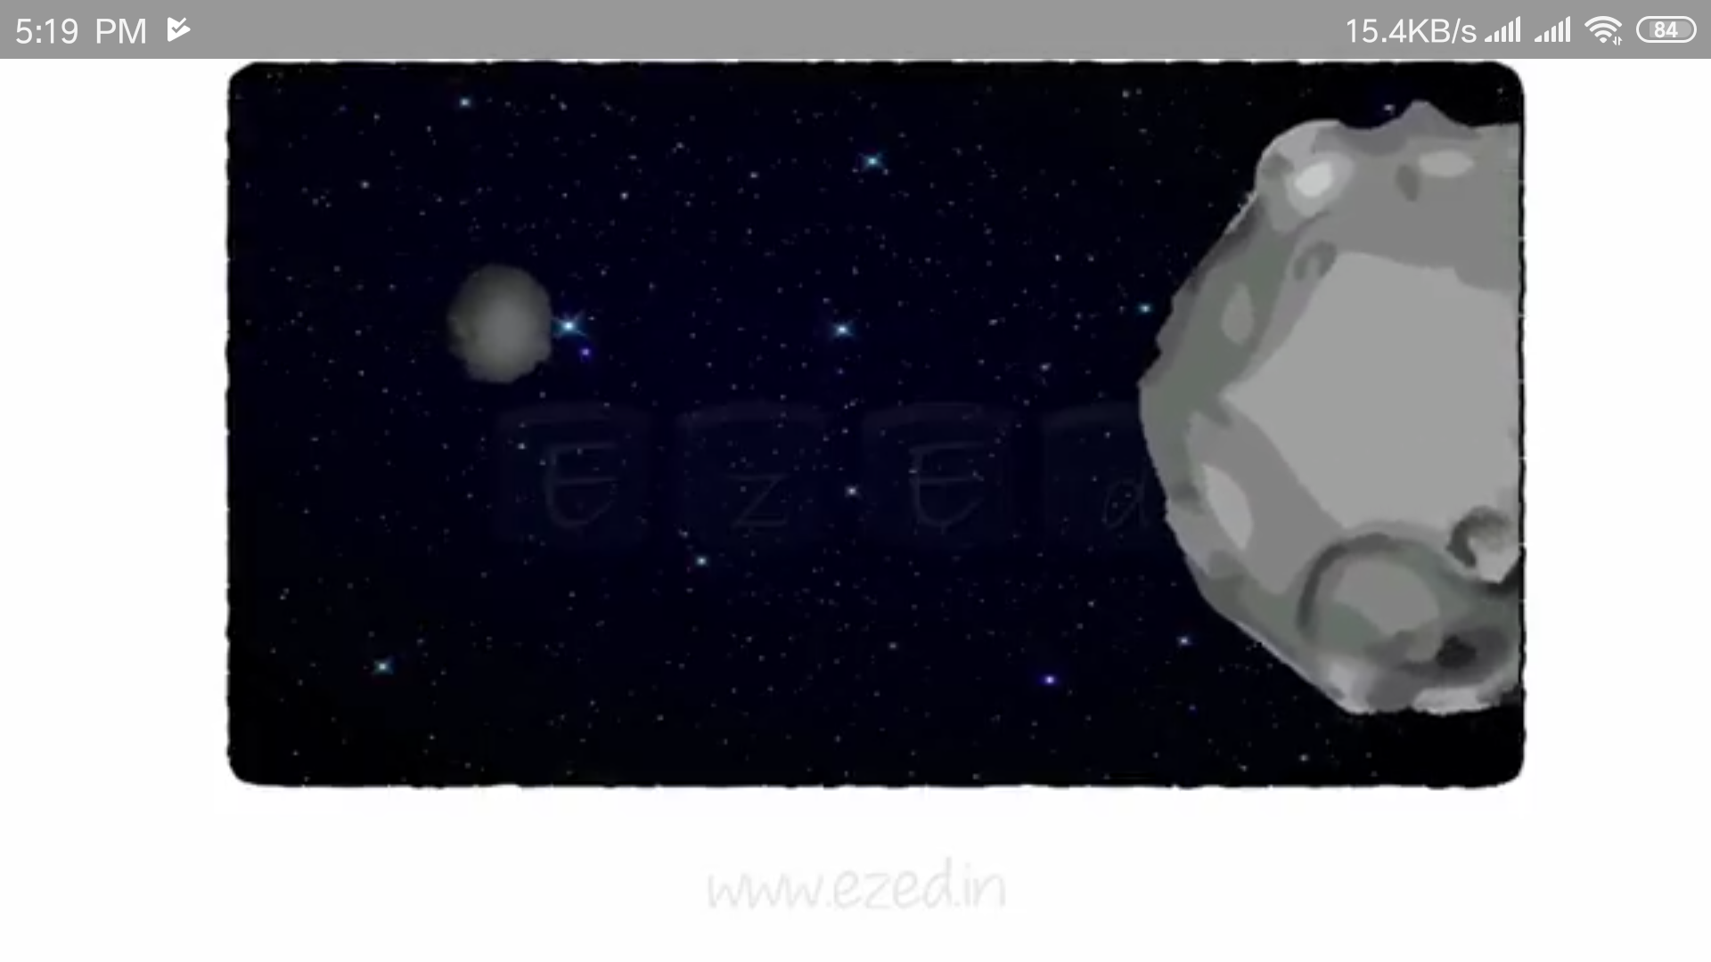
Suppose two object moving:

Slide 40
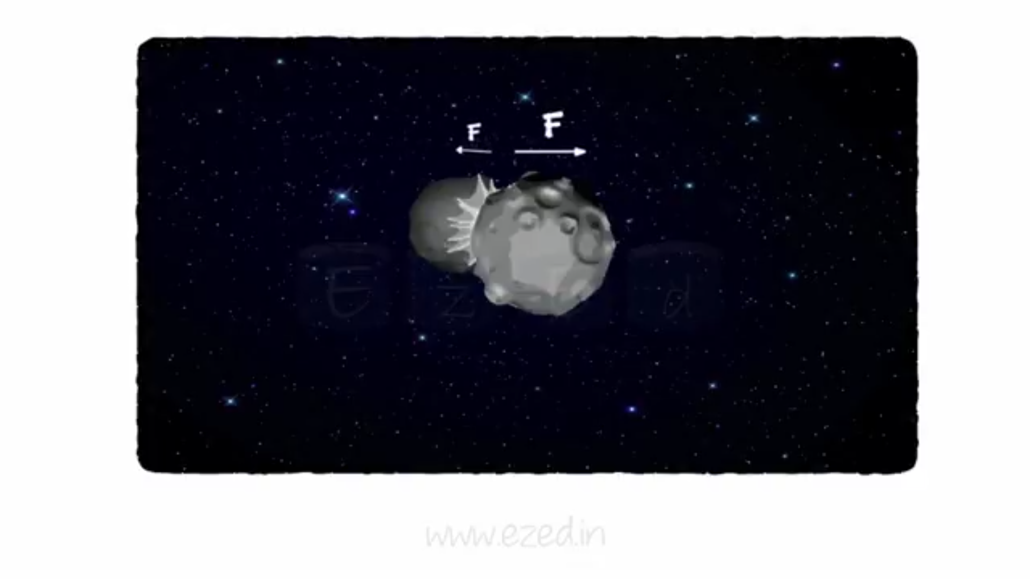
Collide each other producing larger forces within short time.

Slide 41
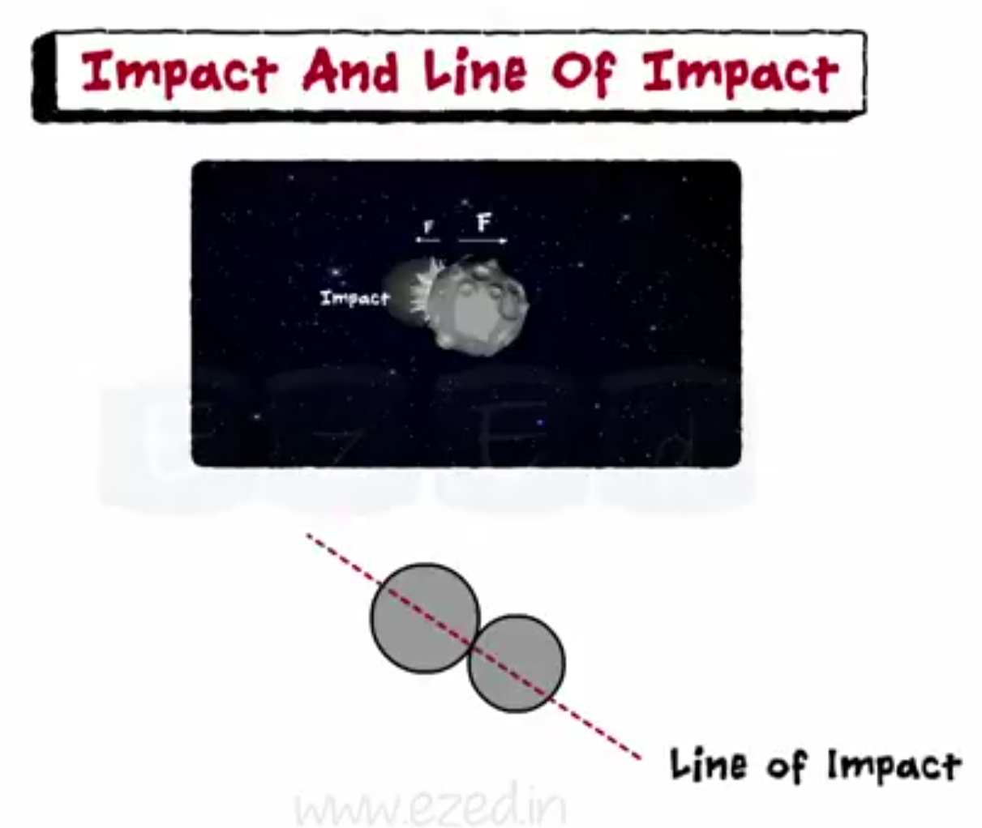

Slide 42
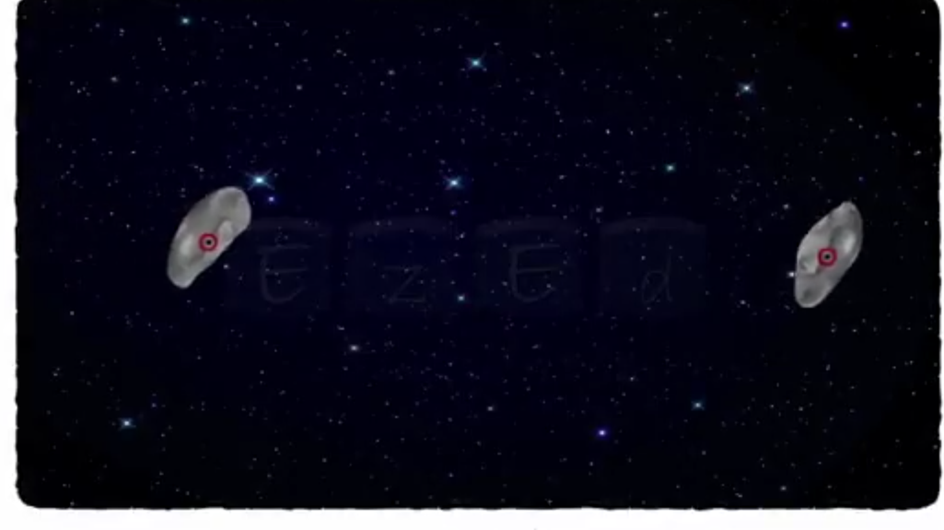
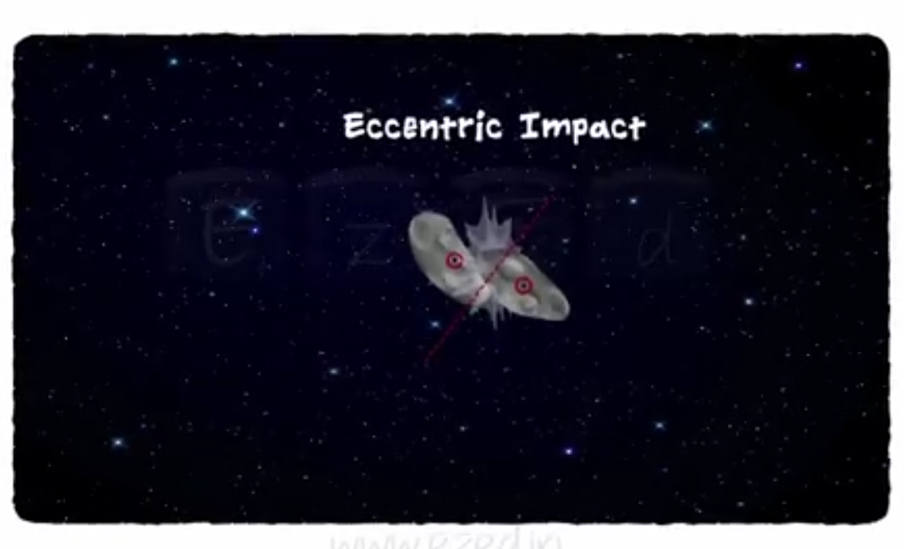
Since mass center of two colliding object doesnot lie in line of impact

Slide 43
Remember:
When two object come in contact, there will be:
Period of deformation
Period of restitution

Slide 44
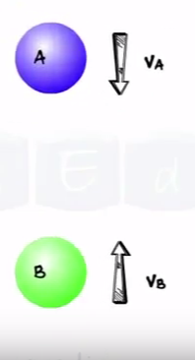
Consider two ball A and B with velocity VA and VB.
Lets assume VA>VB

Slide 45
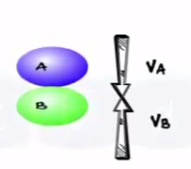
Period of deformation:
On impact deformation begins during the period of deformation, two balls exert large impulsive force on each other.
The deformation of two balls continue to the maximum deformation.
For very small interval of time they move with common velocity.

Slide 46
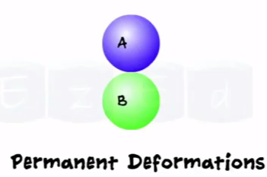
Period of restitution
Then period of restitution begins.
Two ball restore their shape during this period.
Sometimes they may remain permanent deformation. During this period impulsive force exerted by the ball is lesser than during the period of deformation.

Slide 47
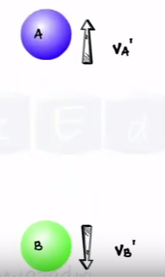
At the end of restitution ,the two balls separate from each other.
Two balls moves with new velocities VA’ and VB’.

Slide 48
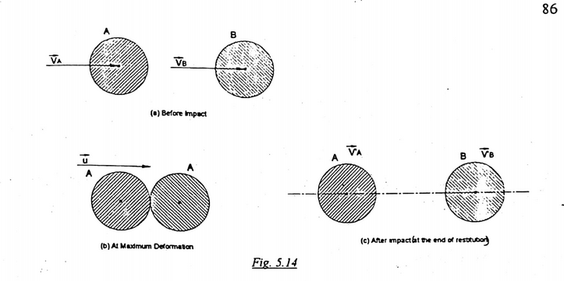

Slide 49
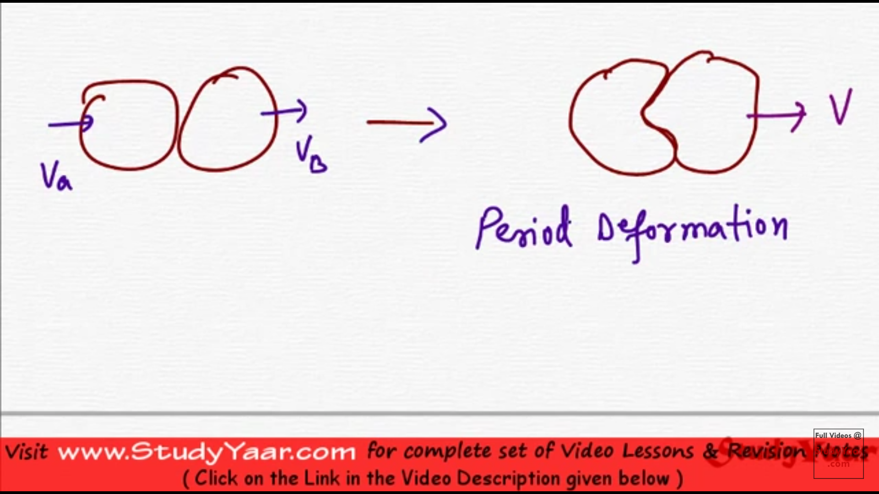

Slide 50
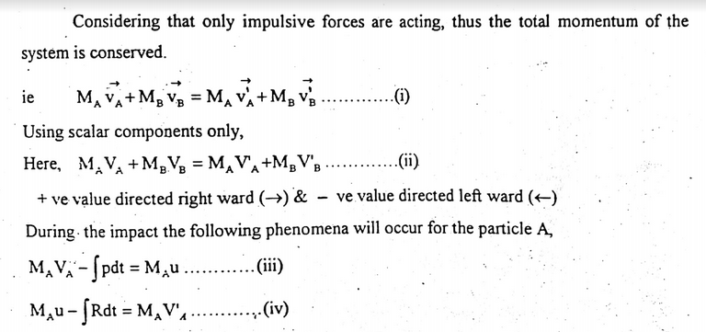

Slide 51
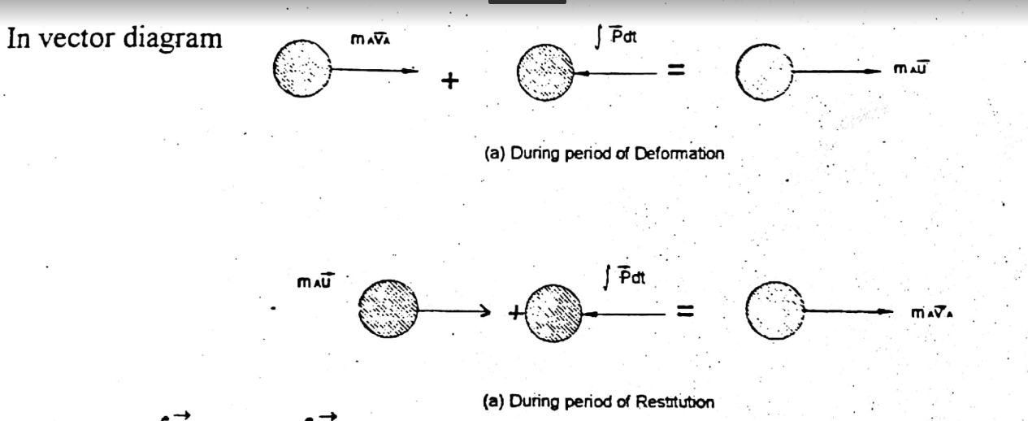

Slide 52


Slide 53
Coefficient of restitution ( e )
It defines the nature of the body.
It is defined as the ability to restore to its original shape and size .
Coefficient of restitution ( e ) depends upon the two materials involved , impact velocity and shape and size of colliding bodies.
Its value varies from 0 to 1.
For perfectly elastic collision, e = 1
For plastic collision, e = 0

Slide 54


Slide 55



Slide 56

Oblique Impact

Slide 57


Slide 58


Slide 59

Steps for solving direct impact problem.
Given:
1.mass m1 and m2
2.velocities
3. e
Find: VA’ and VB’

Slide 60


Since there are no external force acting on colliding body, momentum of system is conserved.

Slide 61




Slide 62


Slide 63


Slide 64


Slide 65


Slide 66


Slide 67

V_{Bn} ‘

Slide 68
Conservative force
The force is independent of the path.
Work done depend on initial and final position only not on the nature of path.
Examples: Gravitational force, spring force etc

Slide 69
Non-conservative forces
A non-conservative force is one for which work depends on the path. Hence it is essential to know where the object starts and stops.
Non-conservative forces are those forces which cause a loss of mechanical energy from the system.
The force depends on the path.
Friction, Air resistance, and Tension in the cord are examples of non-conservative force.

Slide 70


Slide 71


Slide 72


Slide 73


Slide 74

V_{A} = 4 m/s

Slide 75


Slide 76


Slide 77


Slide 78


Slide 79



Slide 80


Slide 81


Slide 82


Slide 83

2.05

Slide 84


Slide 85


Slide 86


Slide 87


